Slide 1
Investment Appraisal
Chapter 8(a)

Slide 2
Lesson Goals
Understand what is meant by time value of money
Be able to carry DCF analysis to assess the viability of a proposed investment proposal
Be able to interpret a discounted cash flow analysis in commercial terms

Slide 3
Introduction
Successful companies always looking to change and develop
Management is faced with different proposals
Not a single way of assessing and comparing different proposals
Factors taken into account
Consistent with company’s long term plans
Risk attached to proposals
Availability of necessary resources

Slide 4
Introduction
One important criteria
Return on investment
Usual way is DCF
DCF tool is used for
Share price of a company
Purchase or lease it
Most financially appealing proposals
A proposed project is worthwhile

Slide 5

The Time Value of Money
The promise of 103Rs for 100Rs in a year’s time
DCF – discounted cash flow analysis
$1/{{\left(1+r\right)}^{t}}$ is known as discount factor

Slide 6
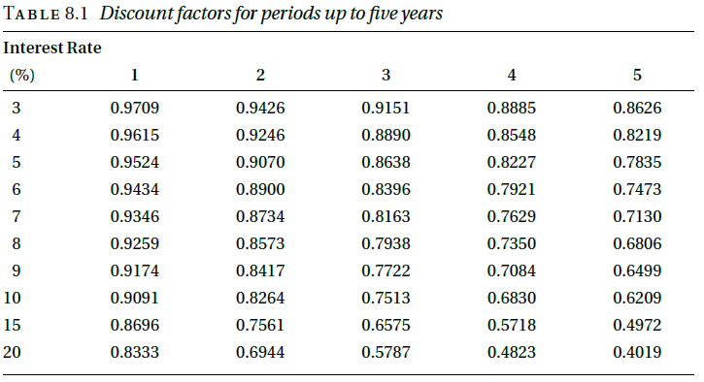
The Time Value of Money

Slide 7
The Time Value of Money
1000 Rs payable in 4 years time with discount/interest rate 8% ?
1000 x 0.7350 = 735

Slide 8
The Time Value of Money
Car Example
Buy or lease
New Wolsey Hornet £8995 or only £500 down and £400 per month for 24 months
Using the idea of discount factors, we can calculate the present value of each of those monthly payments
If we add the present value of all those payments to the £500 that we have to pay immediately, we shall obtain the present value of the total of the payments we have to make
If this is more than £8,995, we shall be better off buying the car outright immediately.

Slide 9
The Time Value of Money
Car Example
The result of applying this function (NPV) to a sequence of 24 payments of £400 with a discount rate of 0.2466 per cent per month (3% annual) is a net present value of £9,310.30.
To this we must add the £500 down payment
This shows that the NPV of the payments on easy terms is £9,810.30.
Clearly we shall be much better off by buying the car outright for £8,995 if we have the money available.

Slide 10
APPLYING DCF TO A SIMPLE INVESTMENT PROJECT
The essence of investment is that money is spent now so as to produce benefits in the future;
Benefits in monetary terms, get present value
To do this, we calculate the net cash flows that the project will generate over each year of its life and convert these to a present day value.
Then we add these up to get the NPV of the project as a whole.

Slide 11
APPLYING DCF TO A SIMPLE INVESTMENT PROJECT
New van cost – 10,000
500 insurance and 150 road tax – annual cost
Maintenance
200 in first two years
300, 400, 500 in year 3, 4 ,5 respectively
Van to be sold at 2000 – end of year 5
Interest rate 10 %
Van hire cost 35 a day – 100 days a year
Inflation 5%

Slide 12
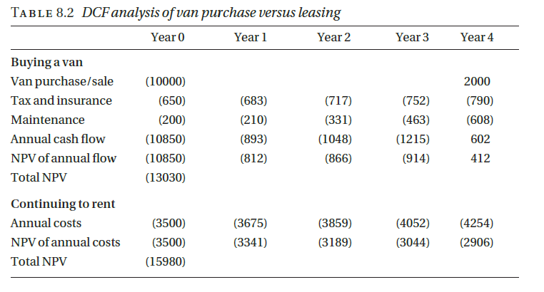
APPLYING DCF TO A SIMPLE INVESTMENT PROJECT

Slide 13
Software Product Proposal
Development
3 people – 1st year
1 and ½ - 2nd year
35000 per year staff cost
Release
2nd year
1 person for maintenance full time
Sales and marketing
10,000 and 20,000 in 1st and each next four years resp
100 copies to be sold in 5 years with 5000 a copy

Slide 14
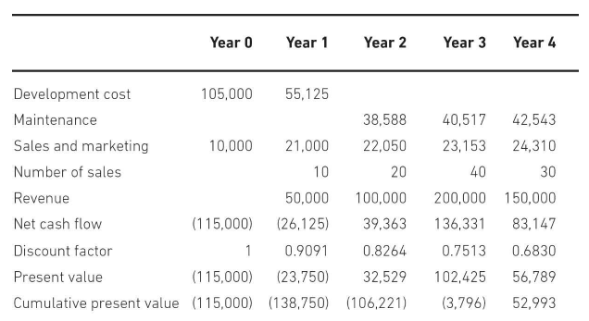
DCF Analysis of a software project

Slide 15
DCF Analysis of a software project
Pay-back period
Time required to get positive cash flow
IRR – internal rate of return
Cost of capital required for NPV to be zero
Proposal to be rejected when;
NPV not positive
Pay-back time is greater than a threshold
IRR is less than current cost of capital
Between 2 projects, with highest NPV is selected, or highest IRR or shortest pay-back time

Slide 16
PITFALLS OF DCF
Too precise in nature
Rely on assumptions
Uncertainty not handled
DCF analysis incase of a software project
Most software takes more time then anticipated
Most software doesn’t work correctly
Not being able to sell copies as much as anticipated
Risk, that competitor will launch similar project

Slide 17
PITFALLS OF DCF
Do DCF analysis with different assumptions and changes
If results vary with small changes-not good-high risk
In the above example
If in year 3, sales drop from 40 to 20, cash flow does not become positive
Project high risk, as sale not to predicted accurately for this long
If price increased to 6000, NPV rises to 117420 - pay-back period falls to 2 years
This sensitivity of changes in sales and price is characteristics of software project development

